Slide 1
ELECTRICAL CIRCUITS (EEE-1103)
Dr. Ismat Rahman
Associate Professor
Department of Computer Science and Engineering
University of Dhaka
*
1

Slide 2
Introduction
Course Name: Electrical Circuits
Course Code: EEE-1103
3 Credit Course
One 1.5 Hours Class in a week
Sunday 11:10 am.
100 Marks Exam
Final Exam – 70 marks
In course Exam (1) – 25 Marks
Assignment/Attendance – 5 Marks
*
2

Slide 3
Books
Introductory Circuit Analysis (11th Edition)
by Boylestad
Class Slides
*
3

Slide 4
Active Week | Topic
week 1 | Chapter 3: Resistance
week 2 | Chapter 4: Ohm’s Law, Power and Energy
week 3 | Chapter 5: Series dc Circuits
week 4 | Chapter 6: Parallel dc Circuits
week 5 | Chapter 7: Series-Parallel Circuits
week 6 | Chapter 7: Series-Parallel Circuits
week 7 | Chapter 8: Methods of Analysis and Selected Topics (dc)
week 8 | Chapter 8: Methods of Analysis and Selected Topics (dc)
week 9 | Chapter 9: Network Theorems
*
4

Slide 5
Active week | Topic
week 10 | In course Exam
week 11 | Chapter 9: Network Theorems
week 12 | Chapter 9: Network Theorems
week 13 | Chapter 10: Capacitors
week 14 | Chapter 11: Magnetic Circuits Chapter 12: Inductors
week 15 | Chapter 13: Introduction to Sinusoidal Alternating Waveforms
*
5

Slide 6
LECTURE SLIDE - 1
Chapter 3: Resistance
*
6

Slide 7
Contents
Introduction
Resistance: Circular wires
Temperature Effect on the Resistance
Types of Resistors: Fixed and Variable
Color Coding and Standard Resistor Values
Conductance
Ohmmeter
Other Devices
*
7

Slide 8
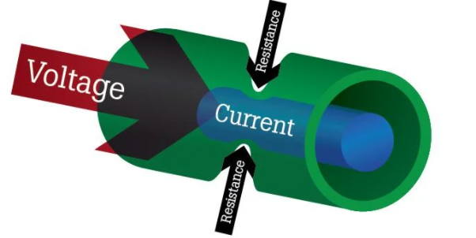
3.1 Introduction
An electric current is a stream of charged particles, such as electrons or ions, moving through an electrical conductor or space.
The flow of charge through any material encounters an opposing force which is due to the collisions between electrons and other atoms in the material, which converts electrical energy into another form of energy such as heat, is called the resistance of the material.
The higher the resistance, the lower the current flow. If abnormally high, one possible cause (among many) could be damaged conductors due to burning.
The lower the resistance, the higher the current flow.
*
8

Slide 9
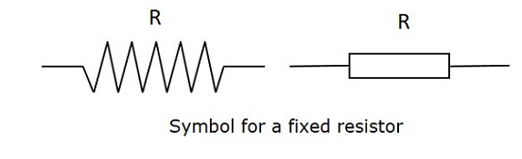
3.1 Resistor
A resistor is a two-terminal electrical component that implements electrical resistance as a circuit element.
A resistor is an electrical component that limits or regulates the flow of electrical currents in an electronic circuit.
The unit of measurement of resistance is the ohm (Ω), the capital Greek letter omega.
The circuit symbol for resistor is given in the following figure and its graphic abbreviation is R.
*
9

Slide 10
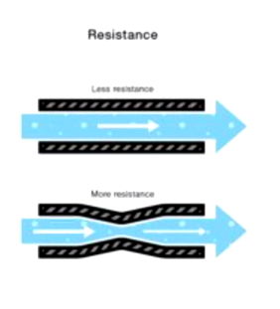
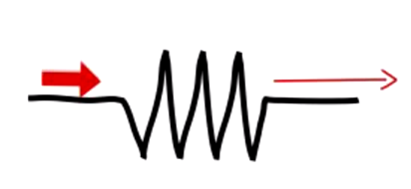
Resistor
*
10

Slide 11
3.1 Introduction
The resistance of any material is depend on the following four factors:
1. Material
2. Length
3. Cross-sectional area
4. Temperature
*
11

Slide 12

3.1 Introduction
The longer the path the charge must pass through, the higher the resistance level, so resistance is directly proportional to the length.
The larger the area (and therefore available room), the lower the resistance; resistance is inversely proportional to the area.
Resistance depends on a characteristic of its material called resistivity (ρ, Greek letter rho). Resistance is directly proportional to ρ.
At a fixed temperature of 20°C (room temperature), the resistance is related to the other three factors by
l is the length of the sample,
A is the cross-sectional area of the sample, and
where ρ (Greek letter rho) is a characteristic of the material called resistivity,
*
12

Slide 13
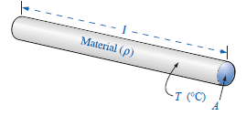
3.2 Resistance: Circular Wires
For a circular wire, factors affecting the resistance of a conductor are defined by the following figure:
For two wires at the same temperature :
1. the higher the resistivity, the more the resistance.
2. the longer the length of a conductor, the more the resistance.
3. the greater the area of a conductor, the less the resistance.
*
13

Slide 14
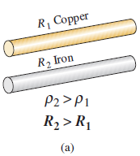
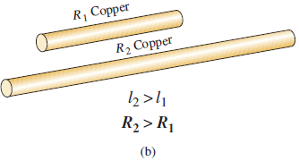
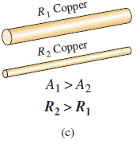
3.2 Resistance: Circular Wires
*
14

Slide 15

3.2 Resistance: Circular Mils (CM)
The area of a circular wires is measured in a quantity called circular mils (CM).
The mil is a unit of measurement for length and is related to the inch by
*
15

Slide 16
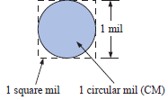

3.2 Resistance: Circular Mils (CM)
The following figure clearly show that the square mil has a larger surface area than the circular mil.
By definition, a circular wire with a diameter of 1 mil has an area of 1 circular mil (CM)
Applying the above definition to a wire having a diameter of 1 mil, we have
[A = ᴨ r² ; r = d/2 ]
*
16

Slide 17



3.2 Resistance: Circular Mils (CM)
Therefore,
So, 1 sq mil = 1.273 CM
For a wire with a diameter of N mils (where N can be any positive number),
So,
*
17
Notes:
17

Slide 18
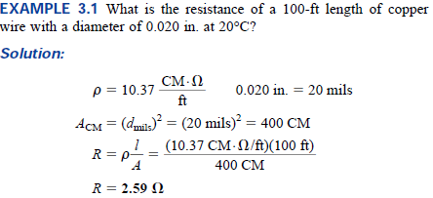

3.2 Example 3.1
*
18

Slide 19
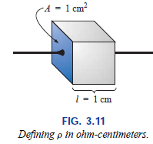
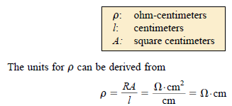
3.4 Resistance: Metric Unit
The resistivity would be measured in ohm-meters, the area in square meters, and the length in meters.
However, the meter is generally too large a unit of measure for most applications, and so the centimeter is usually employed. The resulting dimensions for Eq. (3.1) are therefore
*
19
Notes:
19

Slide 20
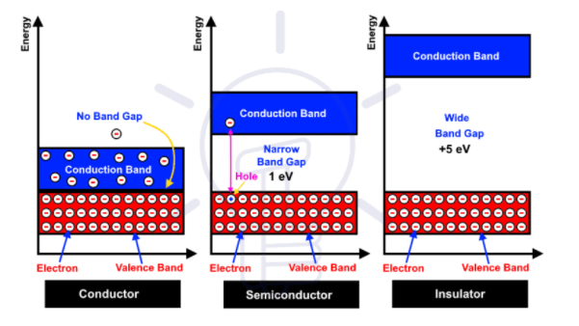
A conductor facilitates the easy flow of an electron from one atom to another atom when the proper application of voltage. This is because there are no band gaps between the valence and conduction bands. Ex: Silver, gold, copper, steel, aluminum etc.
In insulators, there are larger gaps between the conduction and valence bands. The electrons cannot move into the conduction band and this means the material cannot conduct.
In semiconductor, there is a gap between the valance and conduction bands, however, it’s small enough to facilitate the movement of electrons at room temperature, enabling some conduction.
*
20

Slide 21
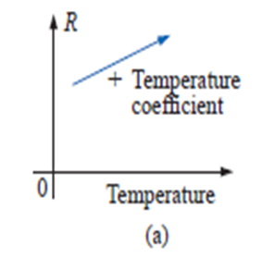
3.5 Temperature Effects
Temperature has a significant effect on the resistance of conductors, semiconductors, and insulators.
Conductor: Conductors permit a generous flow of charge with little external pressure have low resistance levels. For good conductors, an increase in temperature will result in an increase in the resistance level.
As the temperature conductors increases, the increased random motion of the particles within the molecular structure makes it increasingly difficult for the “free” carriers to pass through, and resistance level increases.
The moving free electrons of the metal conductors collide with the other electrons of the metal and generate heat which results in more collisions. This creates a interruption to further movement of the electrons and increases resistance. Consequently, conductors have a positive temperature coefficient.
*
21

Slide 22
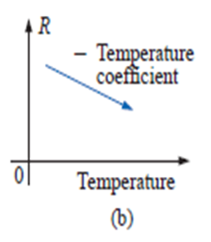
3.5 Temperature Effects
Semiconductor: for semiconductor materials, an increase in temperature will result in a decrease in the resistance level.
Reason: In semiconductors, an increase in temperature results in an increase in the number of free carriers in the material for conduction.
Consequently, semiconductors have negative temperature coefficients.
*
22

Slide 23
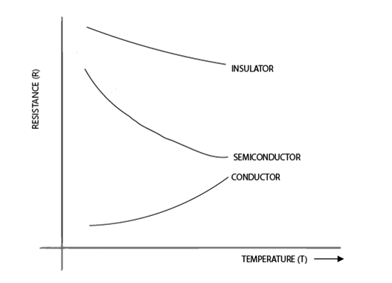
3.5 Temperature Effects
Insulator: As with semiconductors, an increase in temperature will result in a decrease in the resistance of an insulator. The result is a negative temperature coefficient.
The increase in temperature decreases the forbidden energy gap to some extent and starts conduction.
*
23

Slide 24
3.7 Types of Resistors
Resistors are of two types:
Fixed
Variable
The most common of the low-wattage, fixed-type resistors is the molded carbon composition resistor.
The size of a resistor does not define its resistance level.
Resistors of this type are readily available in values ranging from 2.7 Ω to 22 MΩ.
*
24

Slide 25
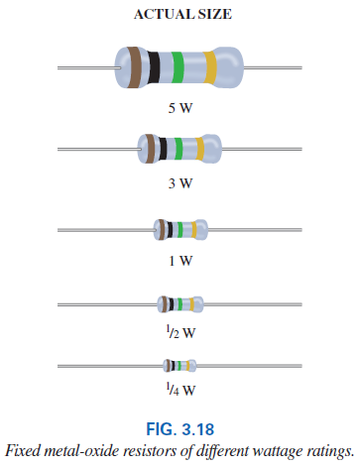
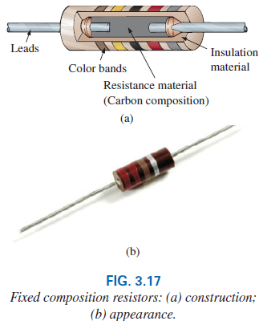
3.7 Fixed Resistors
*
25

Slide 26
3.7 Variable Resistors
Variable resistors have a terminal resistance that can be varied by turning a dial, knob, or a screw.
It has two or three terminals, but most have three terminals.
If the two- or three-terminal device is used as a variable resistor, it is usually referred to as a rheostat.
If the three terminal device is used for controlling potential levels, it is then commonly called a potentiometer.
*
26

Slide 27
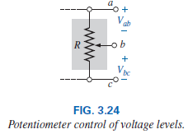
3.7 Variable Resistors
When the device is used as a potentiometer, the connections are as shown in Fig. 3.24. It can be used to control the level of V_{ab,} V_{bc}, or both, depending on the application.
*
27

Slide 28
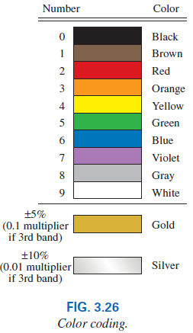
3.8 Color Coding and Standard Resistor Values
A wide variety of resistors, fixed or variable, are large enough to have their resistance in ohms printed on the casing.
Some, are too small to have numbers printed on them, so a system of color coding is used.
For the thin-film resistor, four, five, or six bands may be used.
*
28

Slide 29
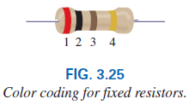
3.8 The Four-band Scheme
For the four-band scheme, the bands are always read from the end that has a band closest to the lead. The bands are numbered as shown as follows:
The first and second bands represent the first and second digits, respectively. (First two numbers that define the numerical value of the resistor.)
The third band determines the power-of-ten multiplier for the first two digits (the number of zeros that follow the second digit for resistors greater than 10 ).
The fourth band is the manufacturer’s tolerance, which is an indication of the precision by which the resistor was made.
*
29

Slide 30
3.8 The Four-band Scheme
If the fourth band is omitted, the tolerance is assumed to be 20%.
The fourth band will be either 5% or 10% as defined by gold and silver, respectively.
In general, the colors start with the very dark shades and move toward the lighter shades.
*
30

Slide 31
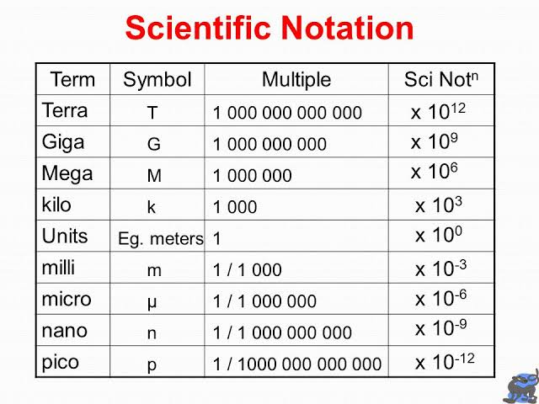
*
31

Slide 32
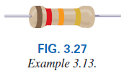
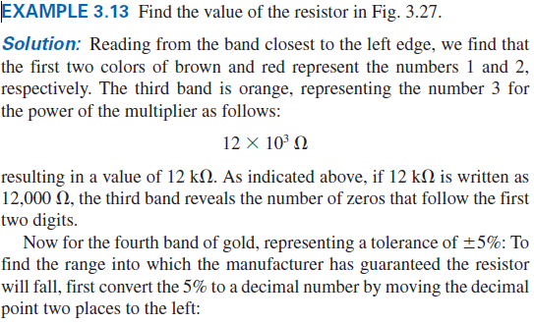
3.8 The Four-band Scheme
*
32

Slide 33
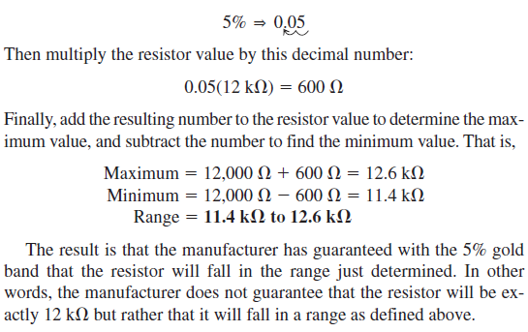
3.8 The Four-band Scheme
*
33

Slide 34
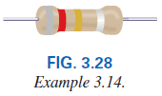
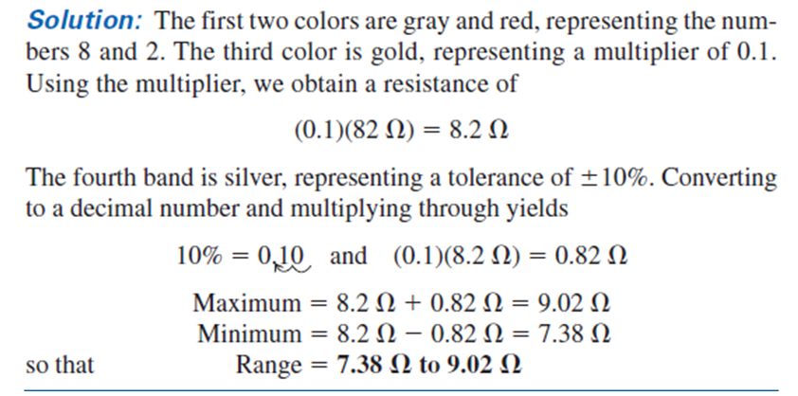
*
34

Slide 35
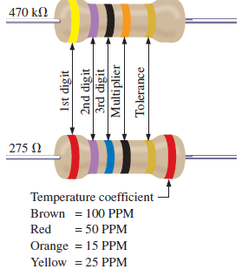
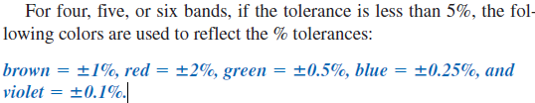
3.8 The Five-band Scheme
Some manufacturers prefer to use a five-band color code. In such cases, three digits are provided before the multiplier.
The fifth band remains the tolerance indicator. If the manufacturer decides to include the temperature coefficient, a sixth band will appear with the color indicating the PPM (parts per million) level.
*
35

Slide 36


3.9 Conductance
By finding the reciprocal of the resistance of a material, we have a measure of how well the material will conduct electricity. The quantity is called conductance, has the symbol G, and is measured in siemens (S):
A resistance of 1 MΩ is equivalent to a conductance of 10⁻⁶ S, and a resistance of 10 Ω is equivalent to a conductance of 10⁻¹ S.
The larger the conductance, therefore, the less the resistance and the greater the conductivity.
*
36

Slide 37
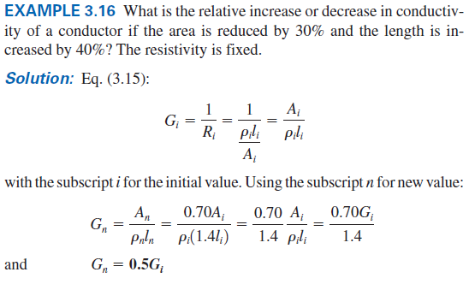
3.9 Example 3.16
*
37

Slide 38
3.10 Ohmmeter
The ohmmeter is an instrument used to perform the following tasks and several other useful functions:
1. Measure the resistance of individual or combined elements
2. Detect open-circuit (high-resistance) and short-circuit (low-resistance) situations
3. Check continuity of network connections and identify wires of a multilead cable
4. Test some semiconductor (electronic) devices
*
38

Slide 39
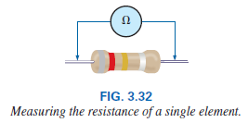
3.10 Ohmmeter
In general, however, the resistance of a resistor can be measured by simply connecting the two leads of the meter across the resistor, as shown in Fig. 3.32.
There is no need to be concerned about which lead goes on which end; the result is the same in either case since resistors offer the same resistance to the flow of charge (current) in either direction.
*
39

Slide 40
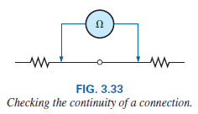
3.10 Ohmmeter
When measuring the resistance of a single resistor, it is usually best to remove the resistor from the network before making the measurement.
A connection can be checked as shown in Fig. 3.33 by simply hooking up the meter to either side of the connection. If the resistance is zero, the connection is secure. If it is other than zero, the connection could be weak; if it is infinite, there is no connection at all.
*
40

Slide 41
3.10 Ohmmeter
Important notes about the use of any ohmmeter:
Never hook up an ohmmeter to a live circuit!
The reading will be meaningless, and you may damage the instrument. The ohmmeter section of any meter is designed to pass a small sensing current through the resistance to be measured. A large external current damage the movement and would certainly throw off the calibration of the instrument.
If the two leads of the meter touch, the small sensing current could drain the internal battery.
*
41

Slide 42
Need to know for EEE lab
How to use a multi-meter
How to use a trainer board
How to use a breadboard
*
42

Slide 43
Thank You
*
43

